Slide 1
Assignment 5 HISTOGRAM USING MATLAB
Mudit Dholakia
MT-006
Guide:-Prof. Tushar .V. Ratanpara

Slide 2
AIM 1
Write a program to find histogram of image without using function. Compare with imhist function. Display original image, Histogram without using function and Histogram with function.

Slide 3
Code:-
clc;
clear all;
close all;
x=zeros(1,256);
x1=imread('lena.jpg');
[a b]=size(x1);
for i=1:a
for j=1:b
x(x1(i,j)+1)=x(x1(i,j)+1)+1;
end
end

Slide 4
Code:-(Cont’d)
xx=1:1:256;
figure,plot(xx,x);
xlabel('Intensity');
ylabel('Number of pixels');
legend('Intensity distribution without imhist()');
figure,
imhist(x1);
xlabel('Intensities');
ylabel('Number of pixels');
legend('imhist()output');

Slide 5
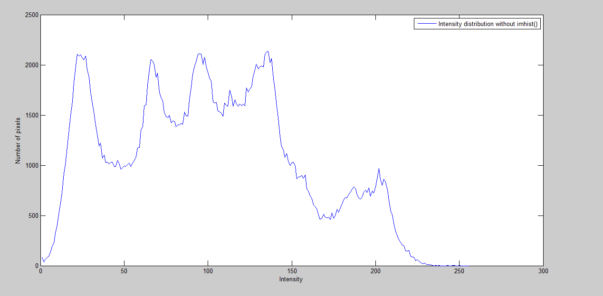
Gray Levels

Slide 6
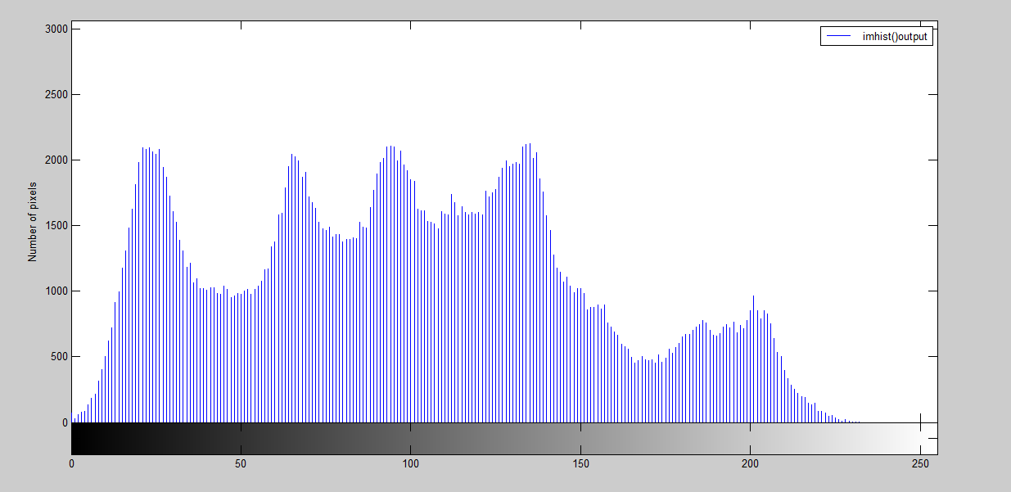
Gray Levels

Slide 7
AIM 2
Write a program to display histogram of original image and equalized image. Display all images.

Slide 8
Code:-
clc;
clear all;
close all;
x=zeros(1,256);
x1=imread('lena.jpg');
figure,
subplot(2,2,1);
imshow(x1);title('ORIGINAL IMAGE')

Slide 9
Code:-(Cont’d)
subplot(2,2,2);
imhist(x1);
legend('Original');
J=histeq(x1);
subplot(2,2,3);
imshow(J);title('EQUALIZED IMAGE')
subplot(2,2,4);
imhist(J);
legend('Histo-equ');

Slide 10
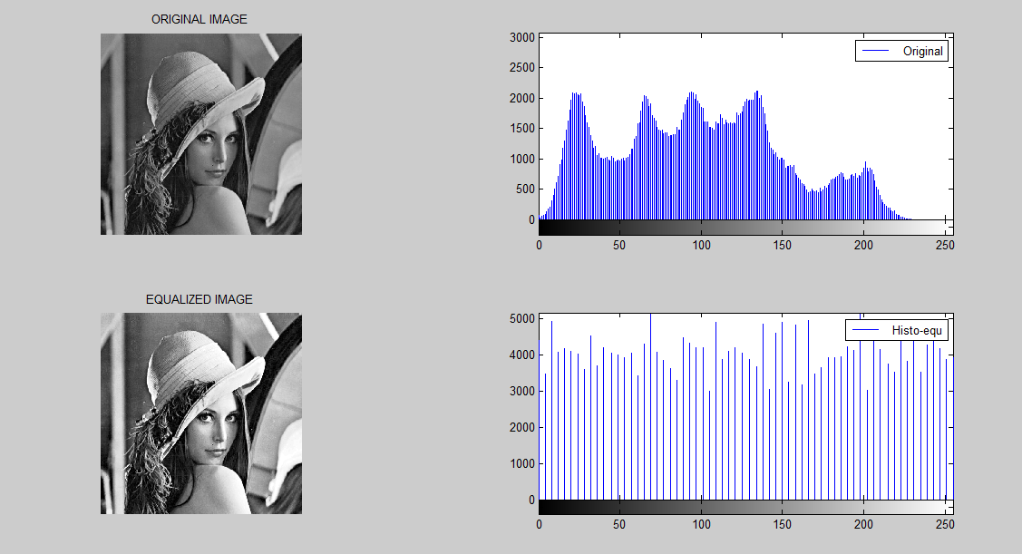

Slide 11
AIM 3
Write a program to display original image, referenced image and histogram matched image. Use following images as original and reference image.
A = imread('concordaerial.png');
Ref = imread('concordorthophoto.png');

Slide 12
Code:-
clc;
clear all;
close all;
A = imread('concordaerial.png');
Ref = imread('concordorthophoto.png');
B=imhistmatch(A,Ref);
%subplot(1,3,1)
figure,imshow(A);title('ORIGINAL')
%subplot(1,3,2)
figure,imshow(Ref);title('REFERENCE')
%subplot(1,3,3)
figure,imshow(B);title('MATCHED IMAGE')

Slide 13
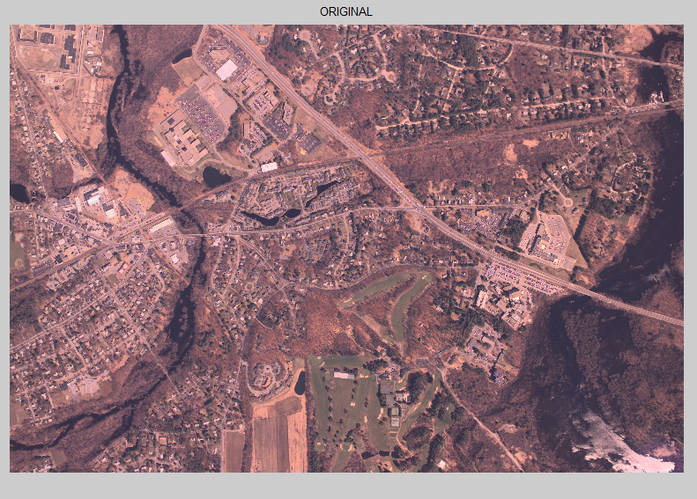

Slide 14
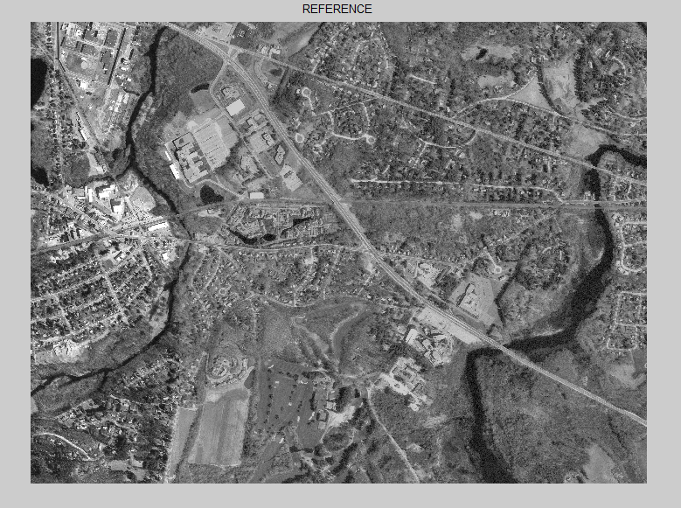

Slide 15
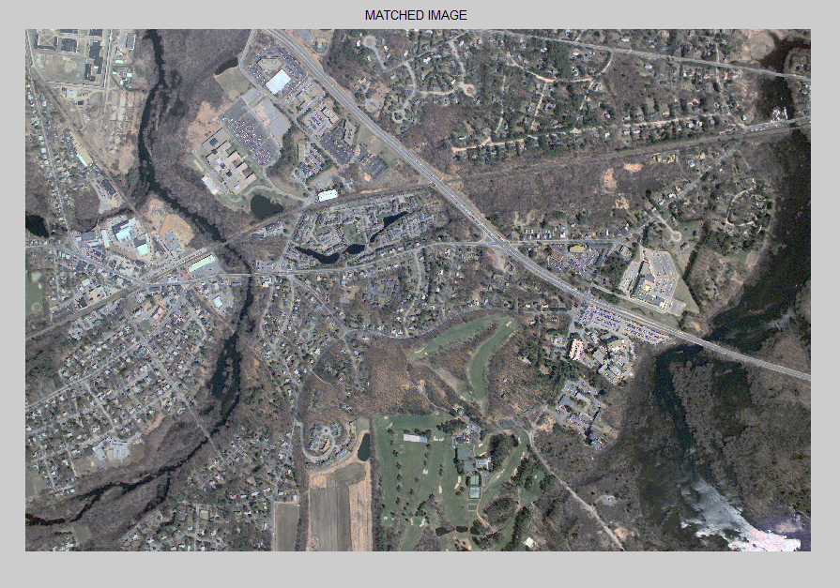

Slide 16
THANK YOU

